Slide 2
Let’s do
this
together

Slide 3
SHOPS
MAKE IT HAPPEN

Slide 4
virtual interview
Rock Your First Impression
Learn how to interview with confidence!
This two-hour workshop will provide you with the information needed to be fully prepared for your next interview.
SHOP

Slide 5
resume
Get Noticed
Out with the old…in with the new!
Learn about the new trends in resume writing, what to highlight, and how to position yourself as a top candidate.
SHOP

Slide 6
branding
Personal Branding & Networking
What’s your brand? In short, it’s your reputation.
Take charge of your professional success—stand out while being your best self. Learn how to network and connect with others.
SHOP

Slide 7
online
Job Search
Discover how to maximize your time and how to separate yourself from other job seekers through an effective online job search.
SHOP

Slide 8
side gig
Supplement Your Income
Learn how work is changing and how to thrive in a gig economy. Explore options for short-term jobs and freelance work as opposed to permanent full-time roles.
SHOP

Slide 9
LinkedIn
Online Networking
Get started with step by step instructions to create your own LinkedIn account. Complete your profile, start networking and unveil valuable connections.
SHOP

Slide 10
soft skills
Shaping Your Soft Skills
Shape up your soft skills before your next job transition. Soft skills are personal attributes that enable someone to interact effectively and harmoniously with other people and can be transferred from job to job.
SHOP

Slide 11
ageless
Overcoming the Age Factor
Learn ways to overcome age-related stereotypes.
Gain insight into working in a multi-generational office, updating a resume, job search and interview techniques.
SHOP

Slide 12
sign up today
waterfordmiworks.org
SHOPS

Slide 13
SMART
PROGRAMS TAILORED TO MAKE IT HAPPEN

Slide 14
Youth
Ages 16-24
Paid Internships
Tuition Assistance
Apprenticeships
Job Search Options
SMART

Slide 15
Navigator
Refugee & Immigrant
Assessment of literacy, numeracy, and English-language proficiency including supportive service needs
Financial Aid eligibility assistance
Referral services
SMART

Slide 16
Career Support
Get Enrolled
Work with a Career Advisor to develop an individualized career plan to include resume review, job search support, and interview preparation.
Attend a CAP enrollment session to get started and discover all the career services offered at our center.
www.WaterfordMIWorks.org
SMART

Slide 17
Veterans
On-site Representative
FREE career assistance with priority of service. Let us help you find the right training and/or career path for your future.
SMART

Slide 18
start today
waterfordmiworks.org
SMART

Slide 20
March Veterans Resource Fair Veterans and their families are invited to stop by WB Parks Connect Senior Center in West Bloomfield. Representatives will be onsite to serve all veterans, active duty, guard and reserves, and their families with resources. RSVP TODAY!

Slide 24
Summer Jobs and Internships with Oakland County
These positions give college students and teens indispensable experience as they prepare for their adult careers, including
Epidemiologist Intern
Sanitarian Intern
Health Education Assistant
Animal Census Worker
Criminal Justice Assistant
Law Clerk Intern
Summer Business Clerk Business Assistant
Laborer
Starting pay ranging from $12.42-$20.38 per hour
Apply oakgov.com/jobs

Slide 26
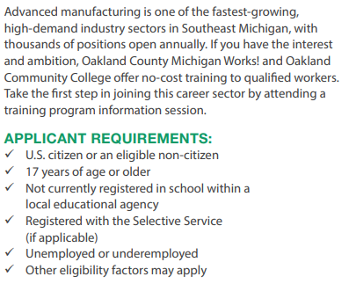

Slide 34
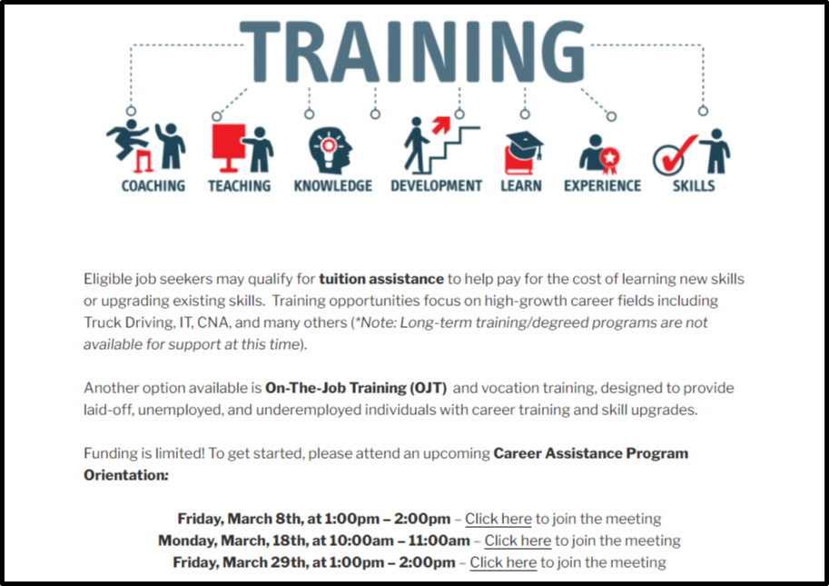

Slide 36
TOGETHER
BUSINESS SOLUTIONS TO MAKE IT HAPPEN

Slide 37
Business
Hiring & Retention Solutions
Career Fairs
Screening
Recruitment
Outplacement
On-the-Job Training
TOGETHER

Slide 38
Follow us
@WaterfordMIWorks

Slide 39
Follow us
@WaterfordMIWork

